Slide 1
3D Surface Pathfinding
By Anish Dhesikan
Algorithms and Data Summer 2015

Slide 2
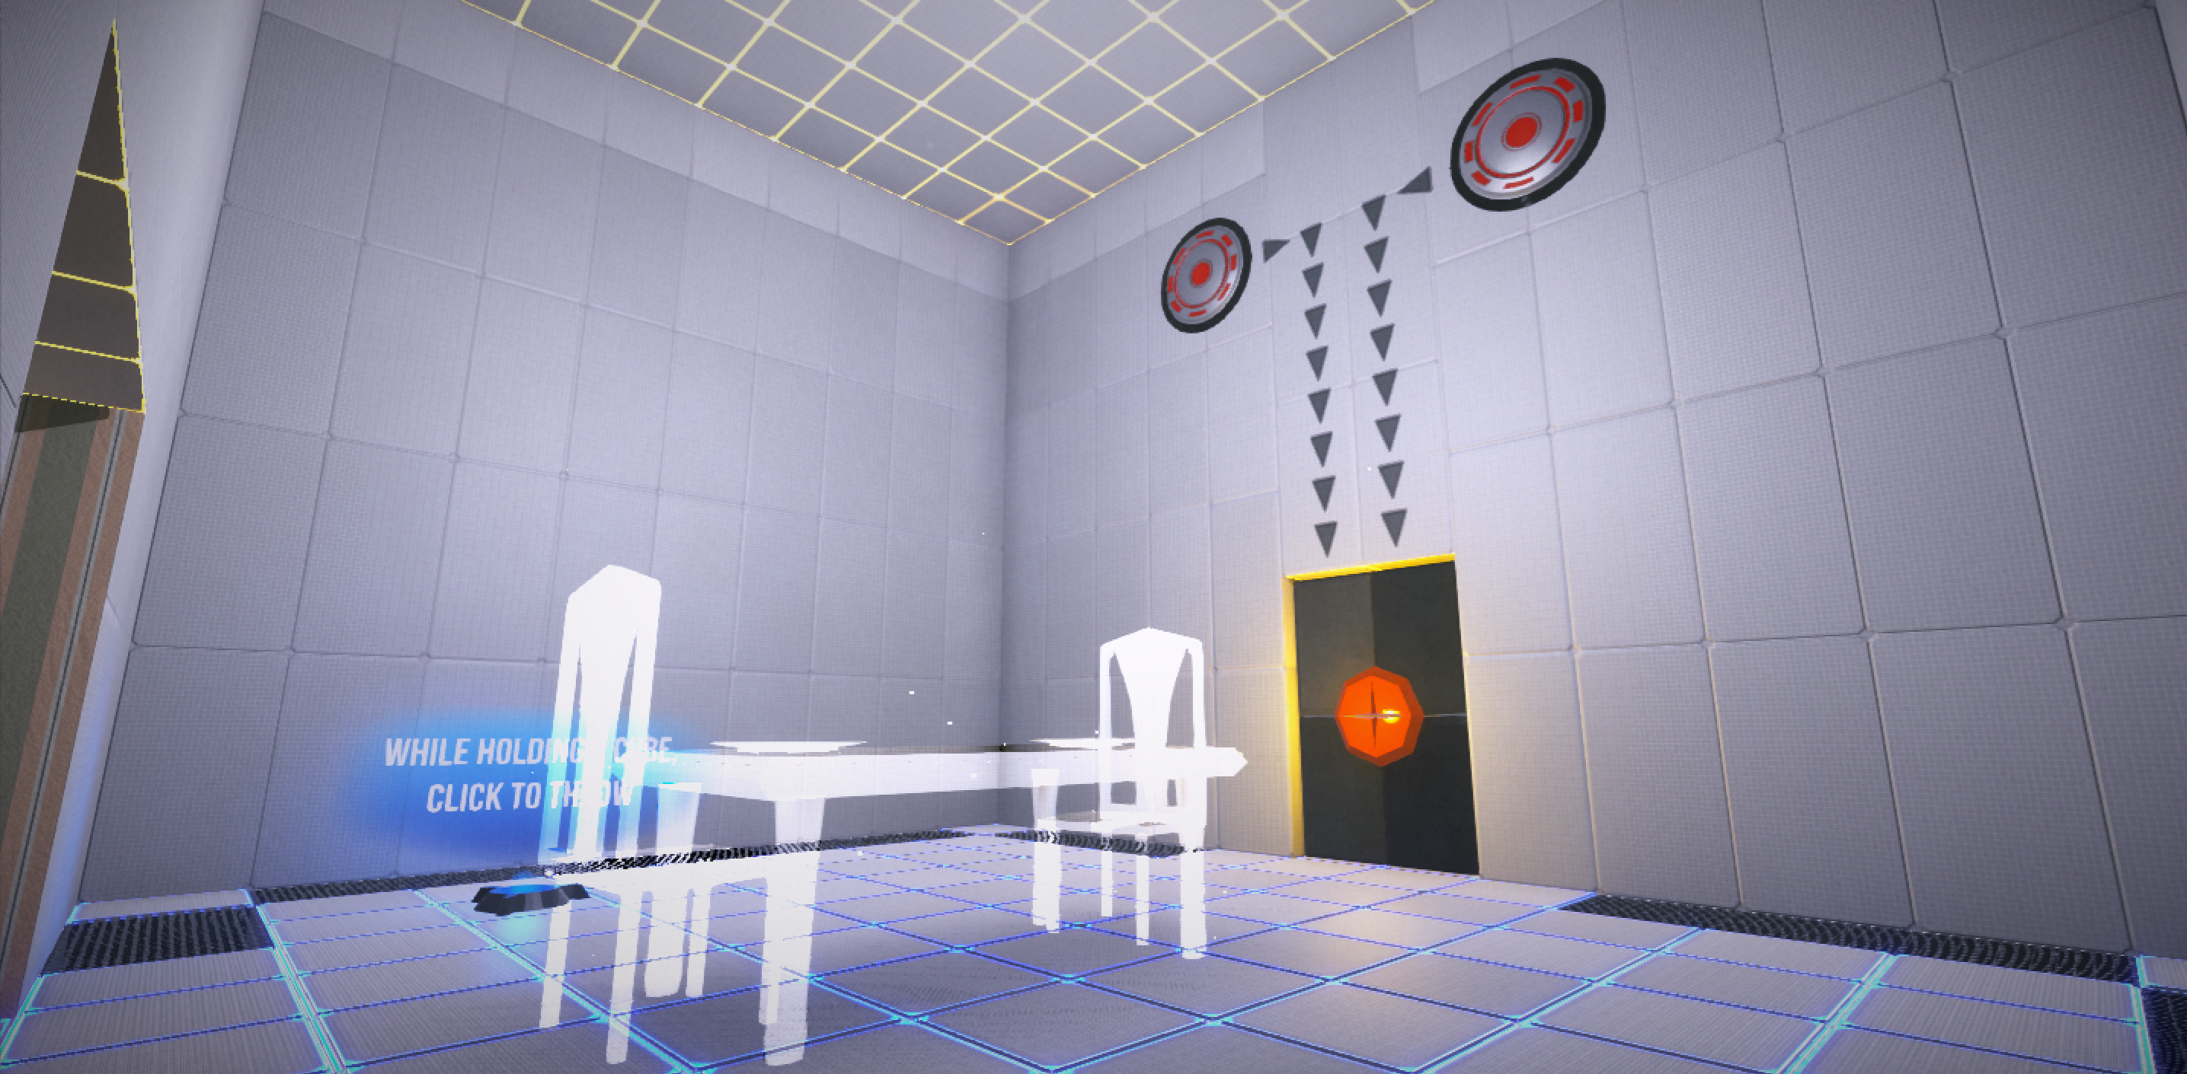
Retrograde: Puzzle Game

Slide 3
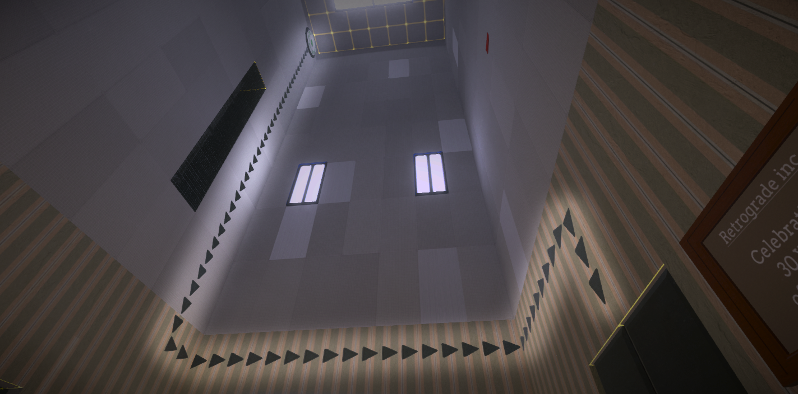
The Problem

Slide 4
The Approach
Looked up pathfinding algorithms
Only 2D, commonly using A*
Tried to simplify 3D into 2D problem
Created a simple model
*See application (skip images)

Slide 5
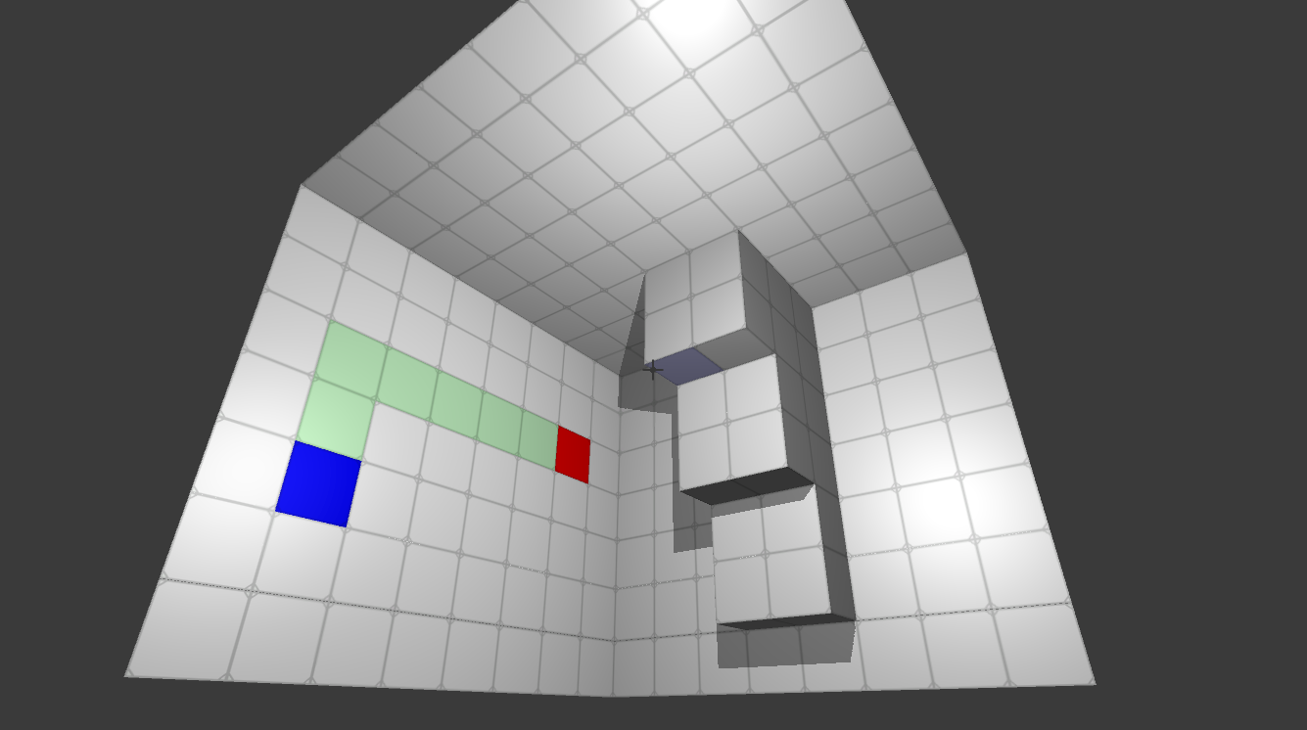
The Algorithm in Action

Slide 6
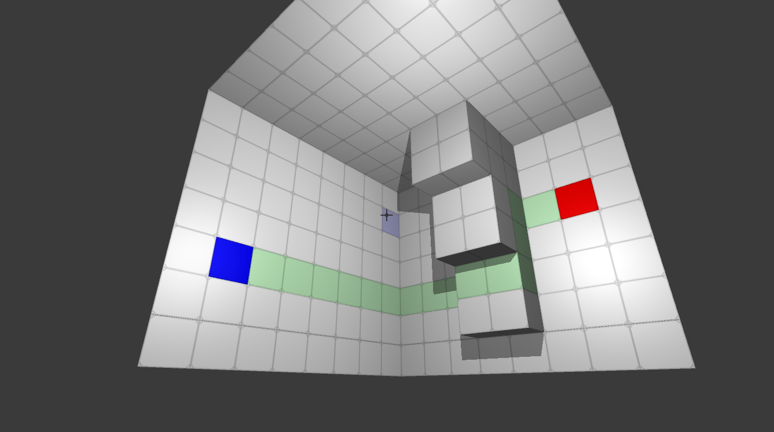
The Algorithm in Action

Slide 7
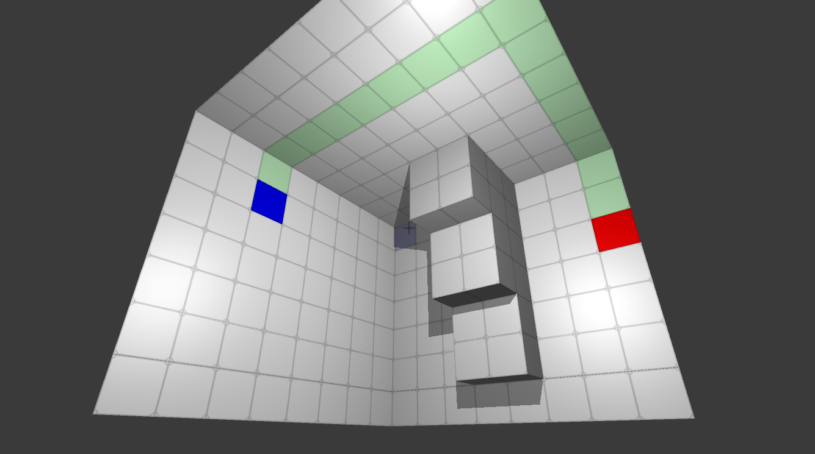
The Algorithm in Action

Slide 8
Failed Attempt (greedy)
Based on locations in 3D space
Pseudocode for this attempt:
Start at a tile. Look at each neighbor
If any neighbor is closer in 3D space to the destination, make it part of the path
Repeat until destination reached.
Does not always terminate

Slide 9
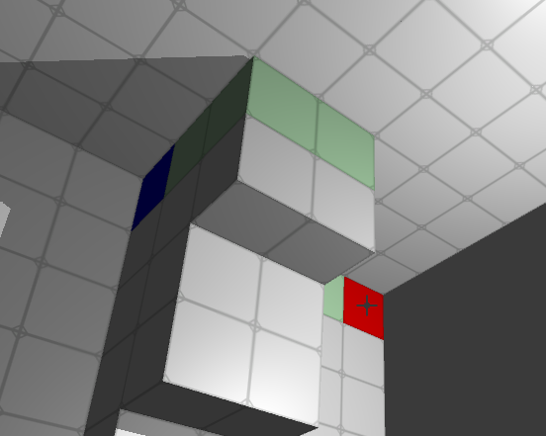
Failed Attempt (greedy)

Slide 10
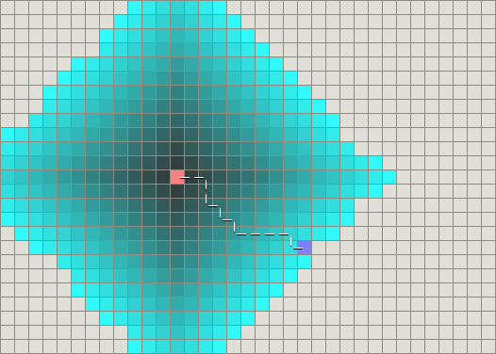
Implemented Method
First step: Model it as a 2D problem
Each tile is connected to 4 neighbors
From here, it’s a simple graph
Dijkstra’s with all edges 1 = BFS
Along the way, set a parent to each node for backtracing

Slide 11
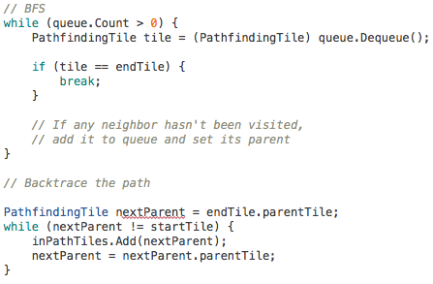
Code Snippet

Slide 12
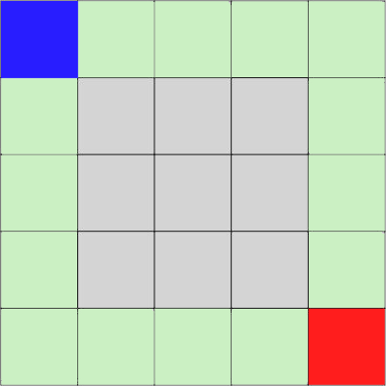
Next Steps
Application to my game
Tiling + connecting 3D models of level environments
Add feature to have “anchor points”

Slide 13
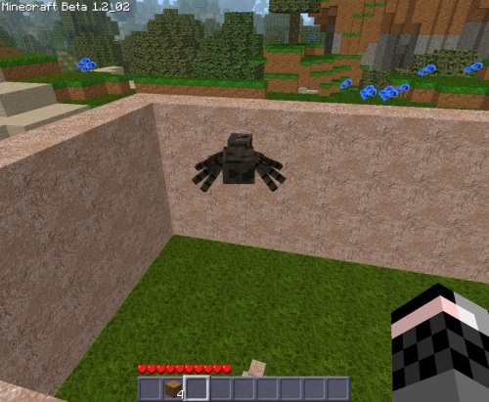
Other Applications
3D surface pathfinding
Wiring in buildings
Spider/Insect AI
Minecraft

